Slide 1
Best 3D digital innovation platform for R&D design and manufacturing
Garry Hsu, General manager
Nov. 3, 2022

Slide 2
About SolidWizard Tech. Co., Ltd.

Slide 3

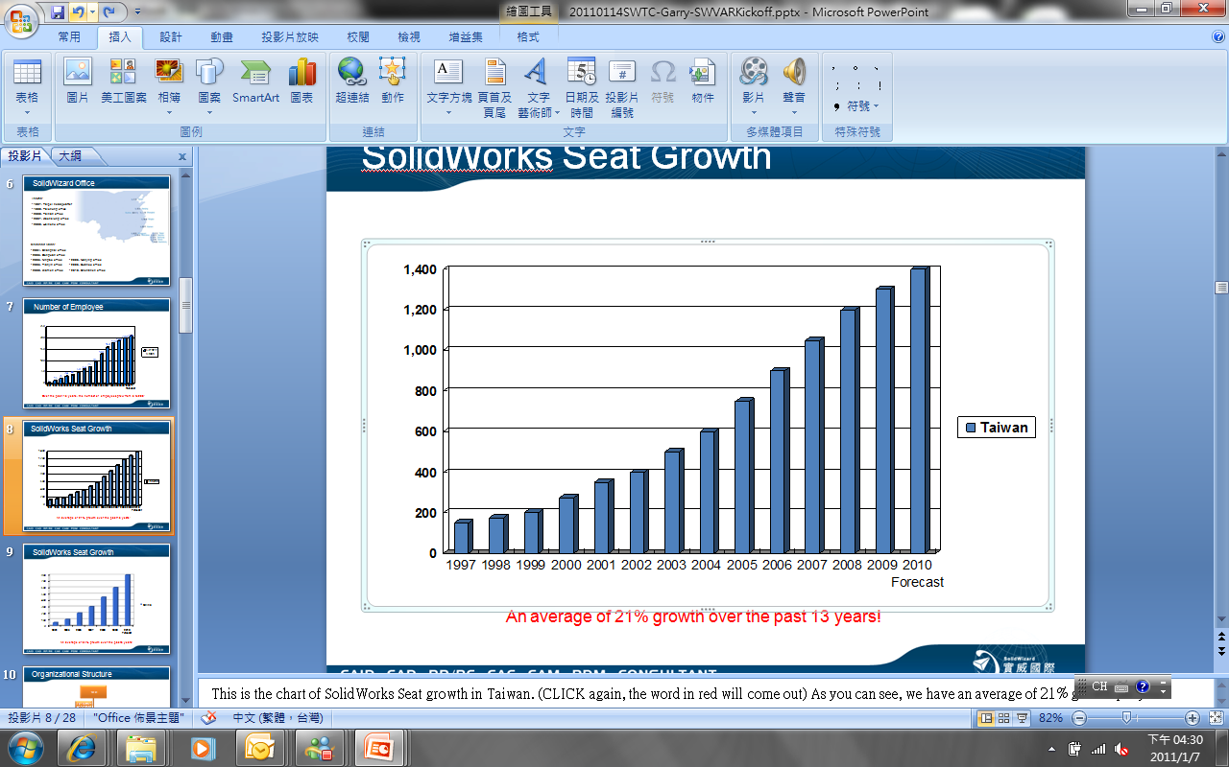
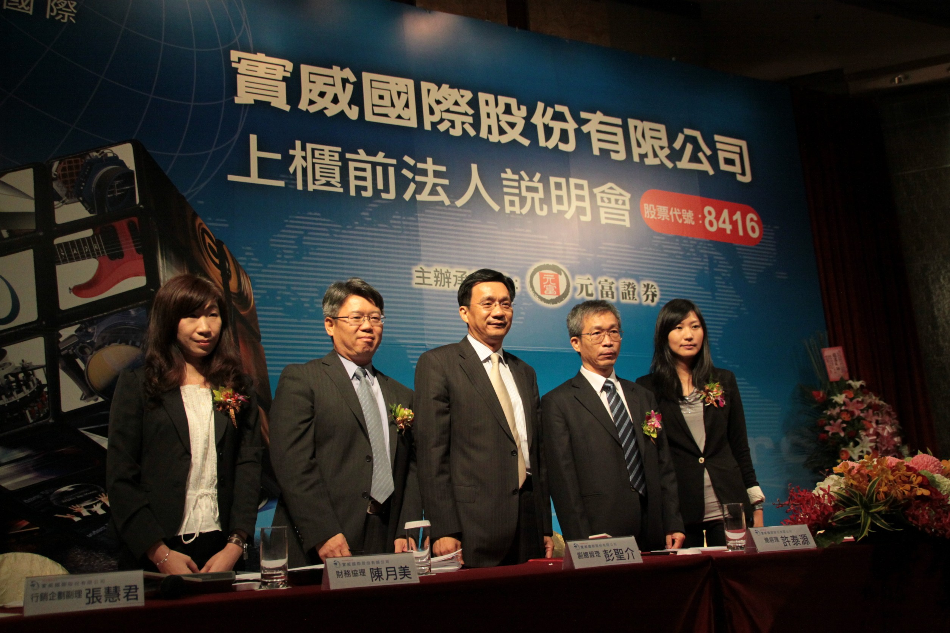
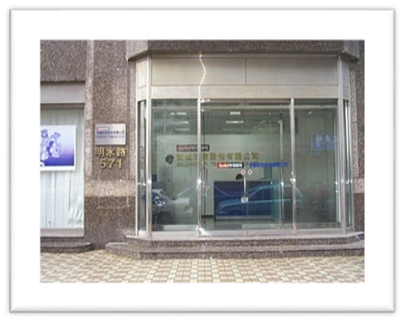







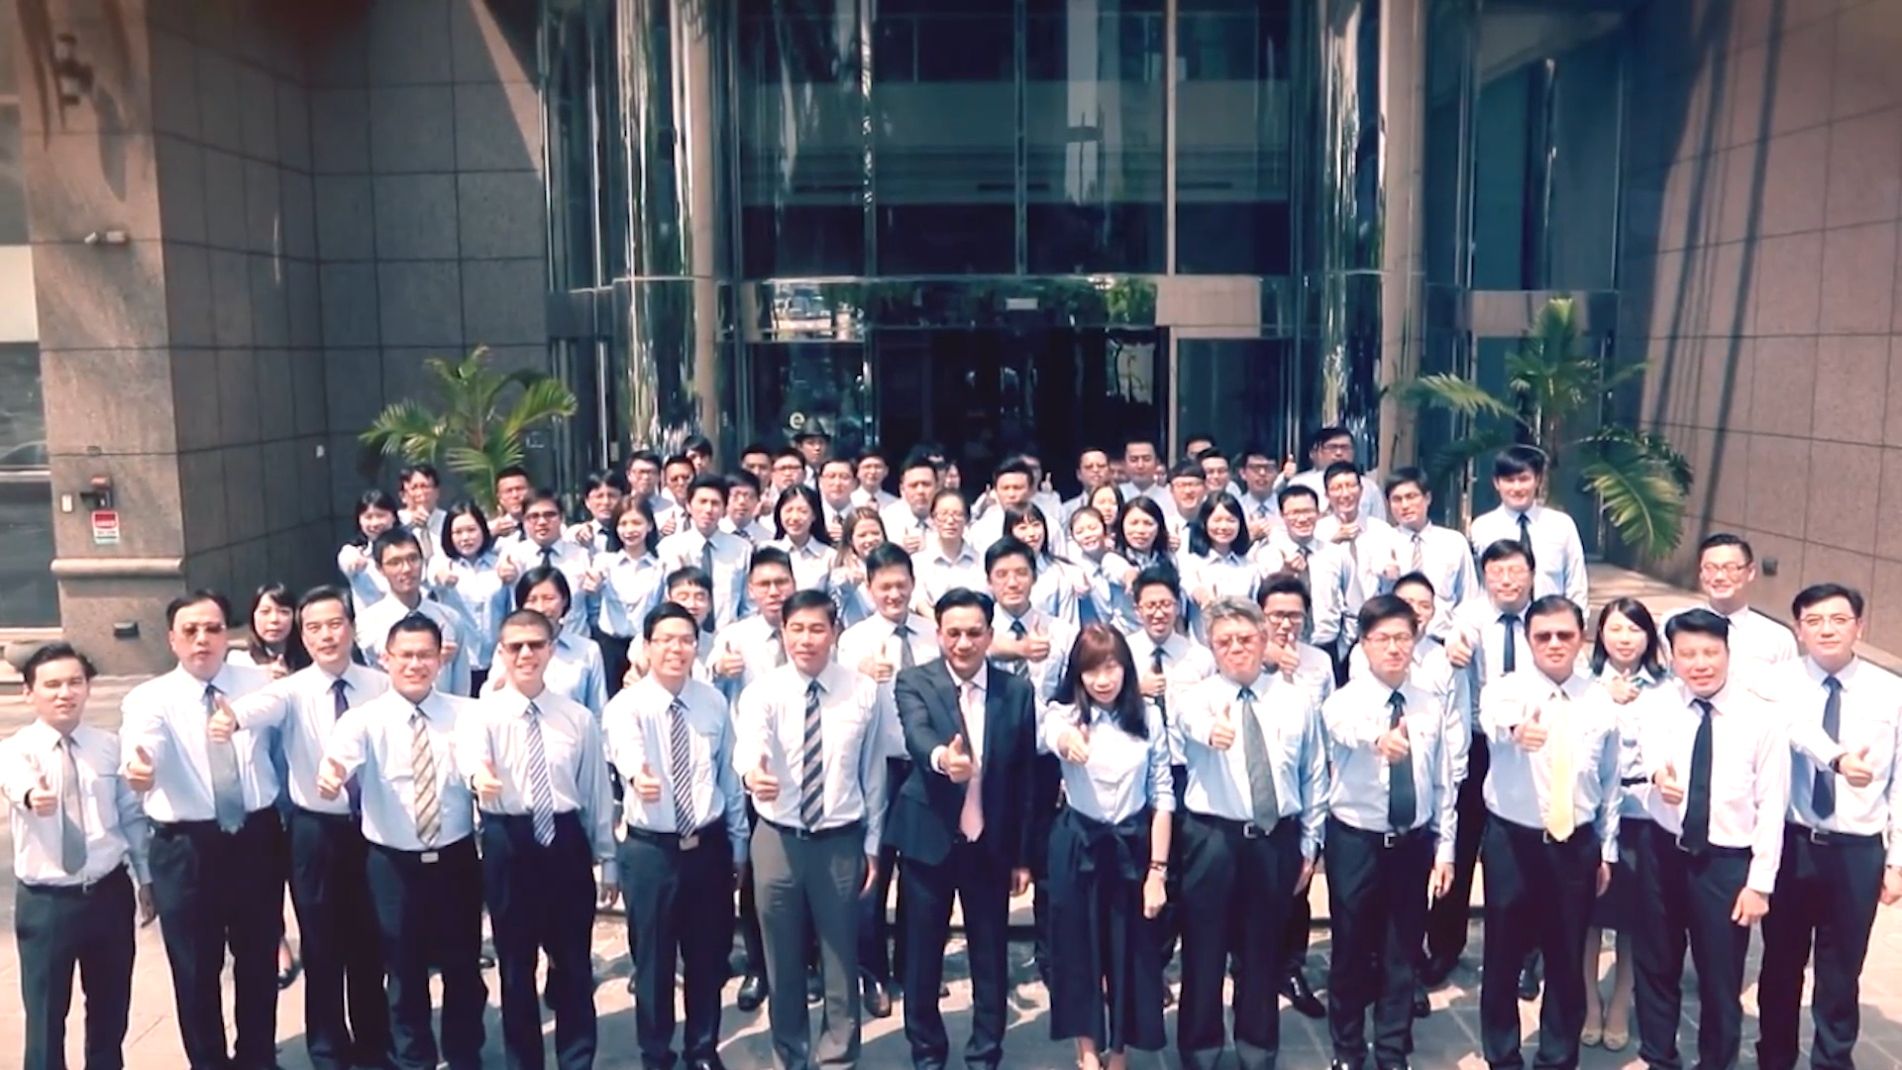


Company history
2022
11 Offices in GC
with 350 FTE
2019
2021
2018
Rev>$1B
2016
2013
2012
Listed (8416)
2004
2004
ShangHai Office Established
1997
Established in Taipei with 5 People.
For 25 years, we still maintain the
entrepreneurial spirit and continue to grow steadily

Slide 4

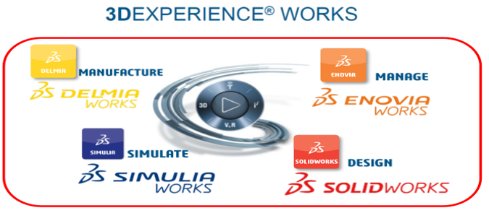
Vision
Becoming the McKinsey Consultant Like for Manufacturing in Asia Pacific
Smart Digital Transformation
With data as the core, to establish a single digital platform, and intelligent shortcuts from design to manufacturing, marketing and sales are connected in series. On the road of enterprise transformation to intelligent manufacturing, SolidWizard can help.

Slide 5
組織圖
Shareholder Association
Audit Committee
board of directors
Compensation Committee
Auditing Office
General Manager
General Manager Office
Sales Department 1
Sales Department 2
Engineering Department
Financial Department
Overseas Office
Consulting Department
CAE Department
Marketing Department

Slide 6




Major Products
Desktop 3D Software
SaaS Cloud
3D Software
Digital Manufacturing Equipment

Slide 7


產品應用
Consumer
Aerospace
Consumer Packaged Goods
Automotive
Life Science
Business Service
Mold Design
Energy
Education
Manufacturing
Hi-Tech Electronics
Notes:
幻燈片資訊：
我們服務於廣泛的行業，解決各種設計難題。SOLIDWORKS 提供了一組功能強大、易於使用且內容豐富的集成工具。事實上，排在全球財富雜誌 500 強企業前 50 名利潤率最高的公司中有 31 家使用 SOLIDWORKS 產品。
要點
SOLIDWORKS 依託於廣泛的客戶群基礎，為各行各業提供兼具深度和廣度的服務。
演講者備註：
無論您將要生成何種產品設計，我們都可以憑藉豐富的專業知識和有效的解決方案，使您達成目標。我們與不同行業的公司合作，一起面對許多不同的工程和商業挑戰。從醫療到航太，從消費產品到教育，説明您克服從產品研發到產品交付的過程中所遇到的各種不同難題。

Slide 8
Business strategy

Slide 9
Accelerate Development Lifecycle
Normal
Concepts
Electrical
Design
Design Validation
Manufacturing
Mechanical
Design
Technical
Communication
What SWTC Give You
Concepts
Manufacturing
Time, Cost, Quality
Integrated Electrical and Mechanical Design
Design Validation
Innovation
Technical
Communication
Data Management
Notes:
解决新的问题
从流程的角度看，我们的方法是什么？
使工程和设计流程可以并行执行，而不是串行执行
为何？
尽早作出更佳的业务决策
创建更出色的设计

Slide 10







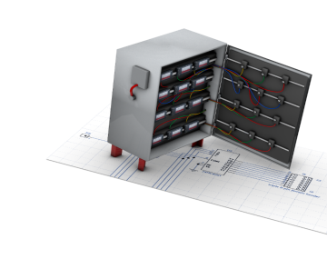
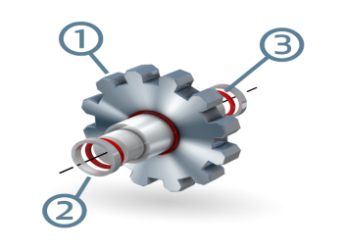
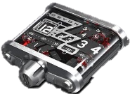
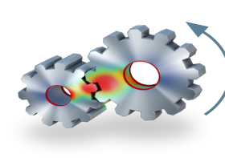

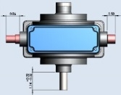
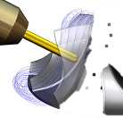
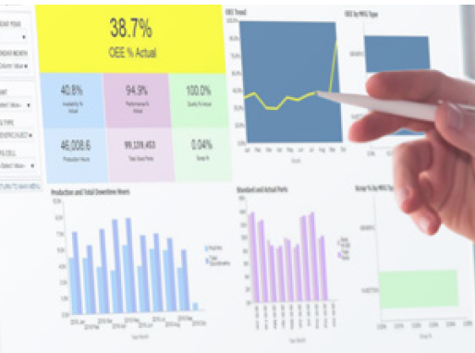



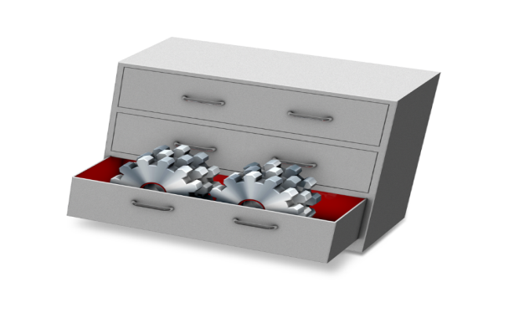

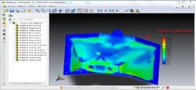

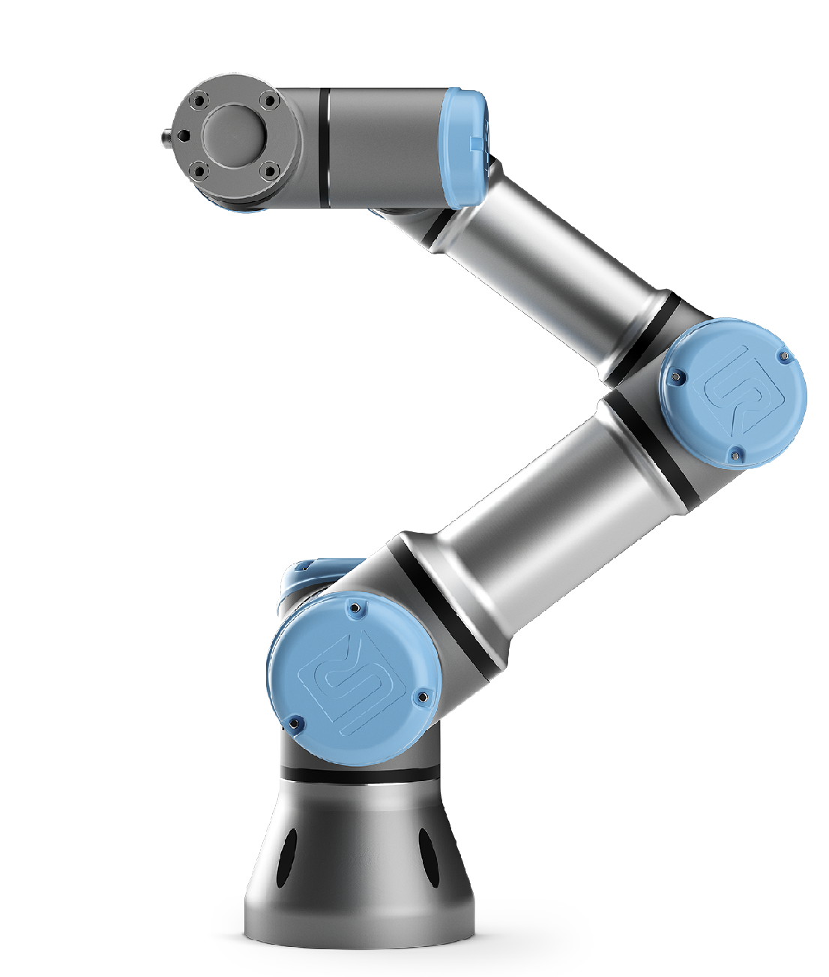
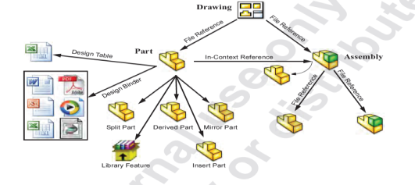
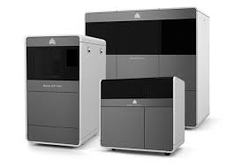
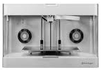
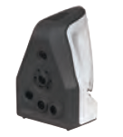
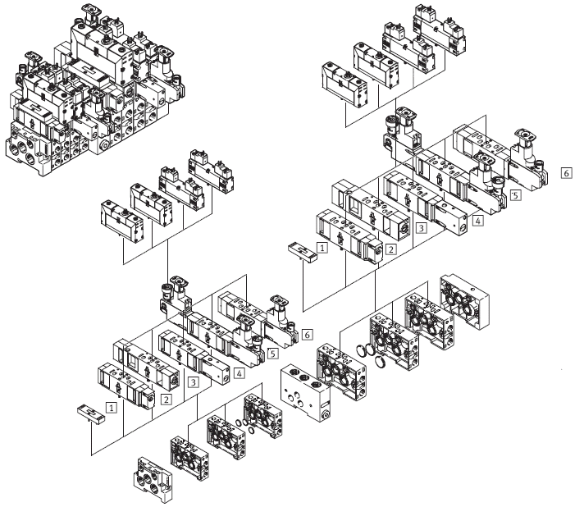
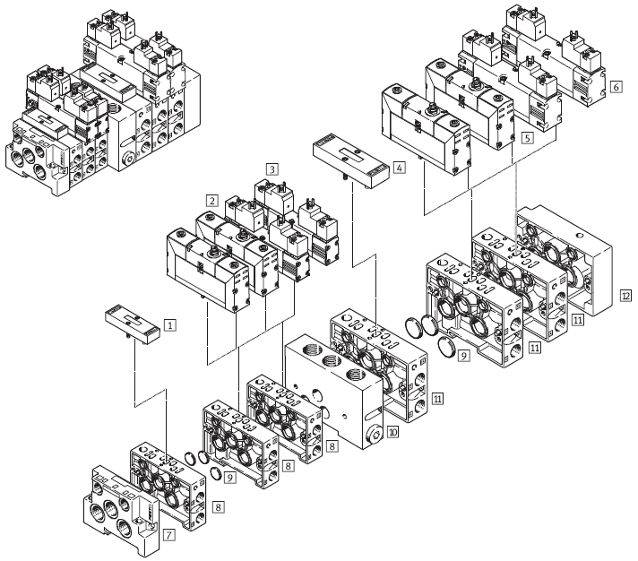
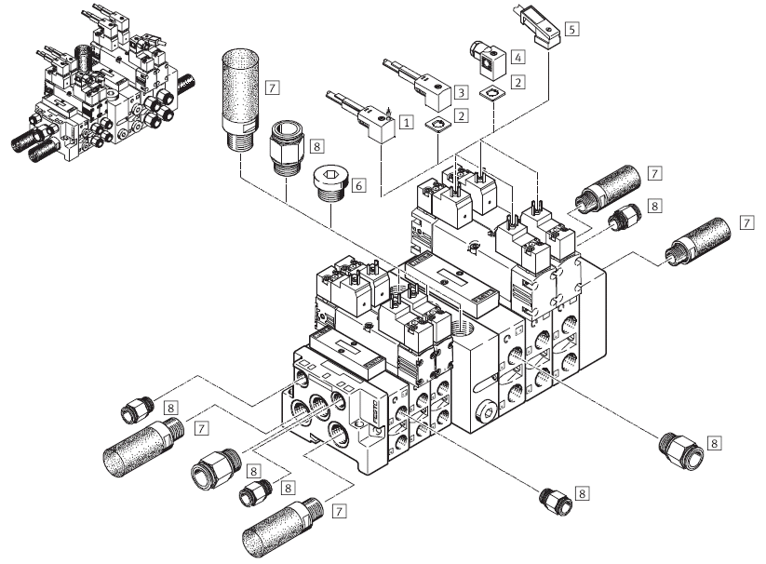
SWTC 3D Innovation Developing Platform
Tool
Design
Marketing/Support
Quality
Production
Operation
機構工程師
電氣工程師
文檔/售服工程師
市場行銷
分析工程師
品管工程師
製造/廠商
製造/生產
營運/排程
營運/財務
SOLIDWORKS
Electrical
Composer
Visualize
Simulation
Inspection
MBD
SW CAM
DELMIAWORKS
Check Out/Check In
Part/Assembly
System
Check Out/Check In
Part/Assembly
Manage-ment
Reading
Engineer
SOLIDWORKS
Eng. Manager
eDrawings
3D Model Design
審核請求
PDM/Manage/PLM/EOP
E Vault/Project Mgt
Design Approval
回饋
Method+Service
3D Scan/Print/
Collaboration Robot
Modular 3D Platform
Standardized Parts Library

Slide 11

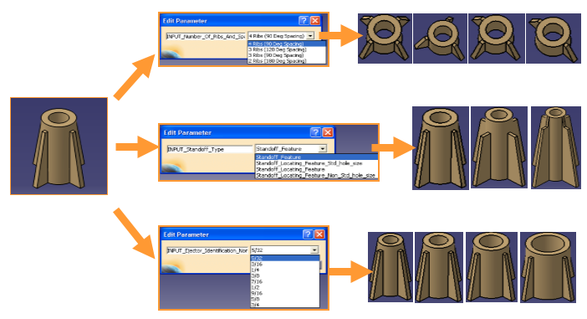
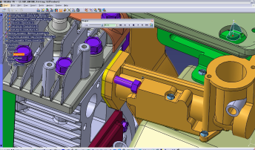

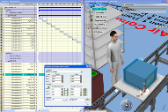
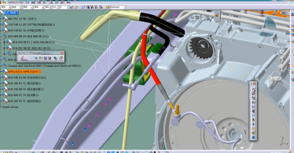

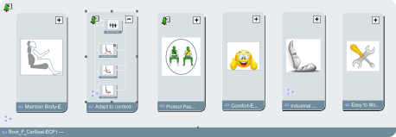
Consultative enterprise digital platform planning
Simulation
Design
Process
Analysis
Validation
Normalize
Approval
Digitalize
Engineering
Validation
Automatic
Plan & Simulate
Standard
Operation
Process
Design Approval
Install & Maintain
Iteration
Design Change
Topology Optimization
Innovation
Operation Instruction
Collaborate
Simulation Mgt.
Design Mgt.
Process Planning Mgt.
Requirements Mgt. & tracking
Project Mgt.
PDM Version Control
Quality Control
Operation
Enterprise PLM Platform

Slide 12







335 Consultative service
5 years strategic cooperation
Level 6
3 years of excellence
Level 5
ENOVIA
Level 4
MANAGE/EOP
/DELMIAWORKS
Level 3
PDM
Level 2
目前
MBD/COMPOSER
/SWI/SWV
/SWCAM
Level 1
SOLIDWORKS
/SIMULAITON
/ELECTRICAL
Level 0
2D TO 3D
SOLIDWORKS
2D
DRAFTSIGHT
American National Committee on Standards and Technology proposed 3D enterprise level model

Slide 13

Maintenance on-time renewal rate
80%/73%/82%
SWTC won the first prize in the Greater China region in 2021

Slide 14




Efficiency improve -3D Platform consulting service
3D Digital Product Development Process
Collaboration Process
Standardization, modularization, automation
People
Process
Tool
Complete Training Course
Improve skill capability
Improve work ability
best practice teaching
Shorten learning curve
Product Development Systems and Tools
System Integration
Customlized System

Slide 15


Slide 16
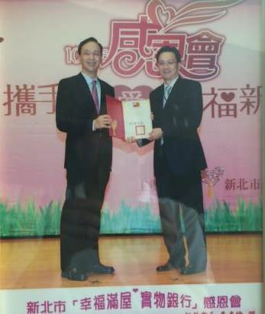
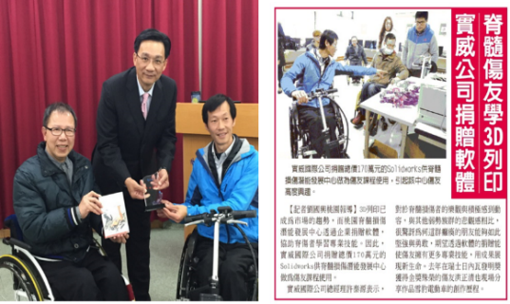
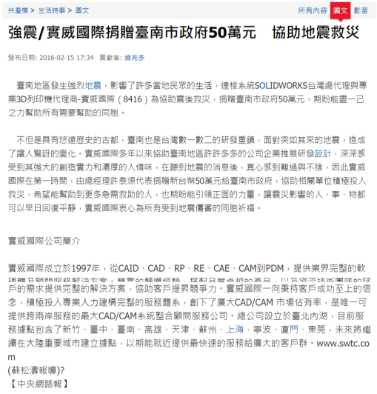
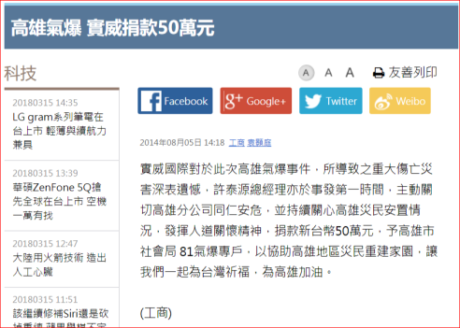
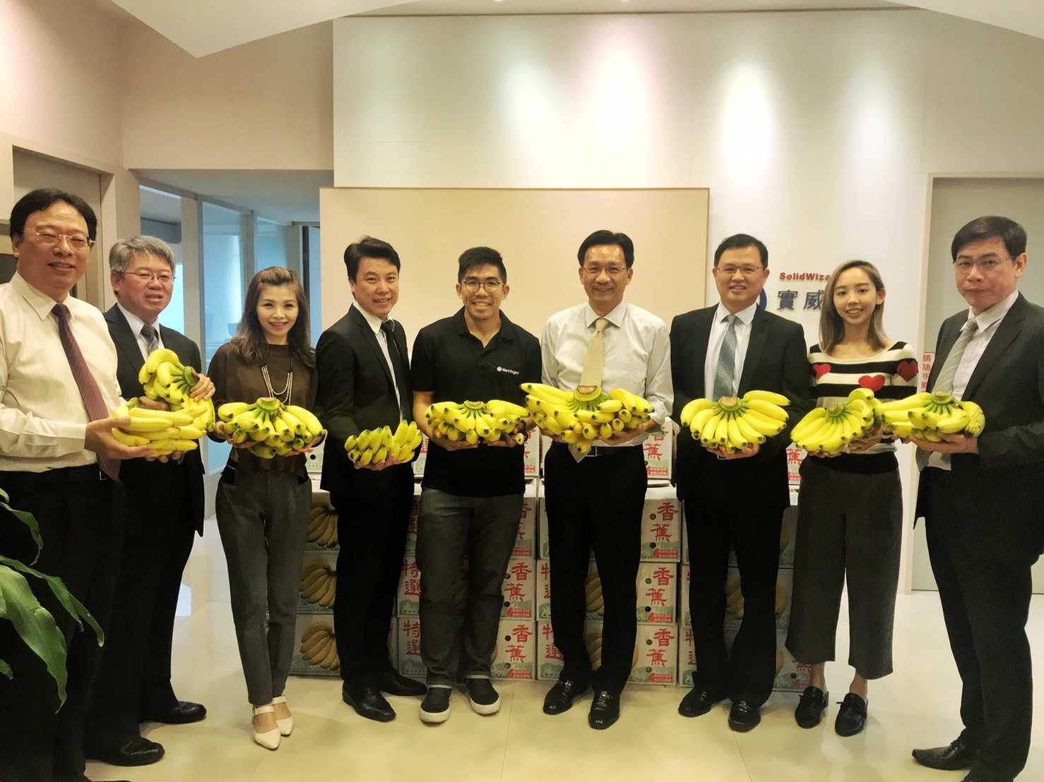

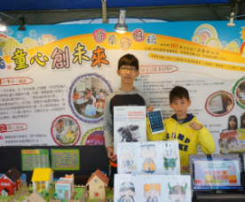
Corporate Social Responsibility

Slide 17



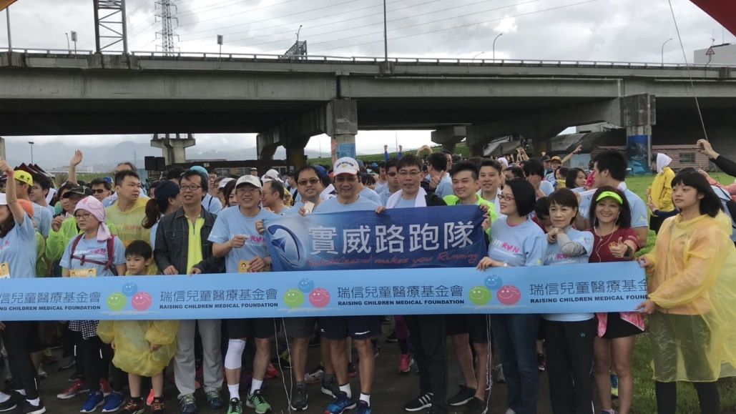

Charity Sponsorship and Employee Marathon

Slide 18
Operating Results and Prospects

Slide 19
Operating results of the last two years
Year | 2020 |  | 2021 |  | 2022(Q1~Q2)
Category | Amount | % | Amount | % | Amount | %
Gross Sales | 1,290,000 | 100.00 | 1,381,774 | 100.00 | 653,642 | 100.00
Cost Of Goods Sold | 610,603 | 47.33 | 647,792 | 46.88 | 298,415 | 45.65
Gross Profit | 679,397 | 52.67 | 733,982 | 53.12 | 355,227 | 54.35
Operating Income | 341,358 | 26.46 | 385,689 | 27.91 | 170,379 | 26.07
Net Income | 280,714 | 21.76 | 320,285 | 23.18 | 132,142 | 20.22
Capital | 282,107 |  | 282,107 |  | 282,107
EPS | 9.95 |  | 11.35 |  | 4.68
(After-tax)
Unit：NTD $K

Slide 20

Competitive Advantage
Asia Pacific Commercial Deployment : One place to buy, two place to serve
5 offices in Taiwan including Taipei, Hsinchu, Taichung, Tainan, Kaohsiung, 6 bases in mainland China including Shanghai, Suzhou, Dongguan, Ningbo, Tianjin, Xiamen, etc. A total of 11 offices
3D digital transformation expert: The only 3D software and hardware integration capability in Greater China
3D Mechanism Design, Electrical Design, Structural/Fluid/Electromagnetic Analysis and Simulation, Product Information/Project/Life Cycle Management, Smart Manufacturing, 3D Printing, Scanning, Robot Arm
More than 100 senior engineers and consultants, providing customer advisory traning and technical support.
No. 1 in SWOLIDWORKS on-time renewal rate and No. 1 in customer satisfaction in Greater China
Customer affirmation: more than 10,000 customer coaching experience
Brand image: SWTC and agency brand with high-quality image
Grow together with customers, provide customers with complete 3D software and hardware integration solutions and services.
Cloud/Advanced Analytics Commercial Deployment: New Markets, New Customers, New Performance Growth Engines
Provide customers with 3D cloud collaborative design solutions that are deployed in advance
Provide aerospace, electric vehicle and network communication market advanced structure, fluid, electromagnetic analysis solutions

Slide 21

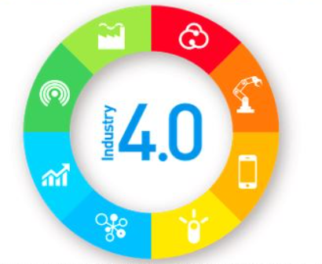


Future Development
McKinsey-style consultancy
SaaS Platform
Cloud/Big Data
Design Collaboration
Digital Manufacturing
Desktop/Ecosystem
AI /VR & AR

Slide 22



Future Vision
Short-Term
Med-Term
Long-Term
Brand Establishment
In Great China
Brand Awareness in Asia-Pacific
Build Own Brand Application and Marketing Worldwide

Slide 23








Q & A

Slide 24

~ Driving design, leading manufacturing ~

